Slide 1
Escenic Playback
Wipro Escenic Team
Notes:
The below and following notes on the template slides are to guide you only. In your final presentation, you may delete these notes and add relevant notes if any.
Title slide:
Title – should not exceed beyond 3 lines, font size 30-34, Arial Headings
(Font size for the title of the PPT can vary between 30-34, Arial Headings, Bold depending on the amount of text, however should not be smaller than 30 font size)
Name should not exceed beyond 1 line, Designation; font size to remain at 18, Arial Headings
Please keep the title slide simple, just the logo, title and name and designation to appear. No other graphic elements or any design, photograph, image can be added to this slide, alignment to remain the same

Slide 2
Architecture Overview
Notes:
The below and following notes on the template slides are to guide you only. In your final presentation, you may delete these notes and add relevant notes if any.
Title slide:
Title – should not exceed beyond 3 lines, font size 30-34, Arial Headings
(Font size for the title of the PPT can vary between 30-34, Arial Headings, Bold depending on the amount of text, however should not be smaller than 30 font size)
Name should not exceed beyond 1 line, Designation; font size to remain at 18, Arial Headings
Please keep the title slide simple, just the logo, title and name and designation to appear. No other graphic elements or any design, photograph, image can be added to this slide, alignment to remain the same

Slide 3
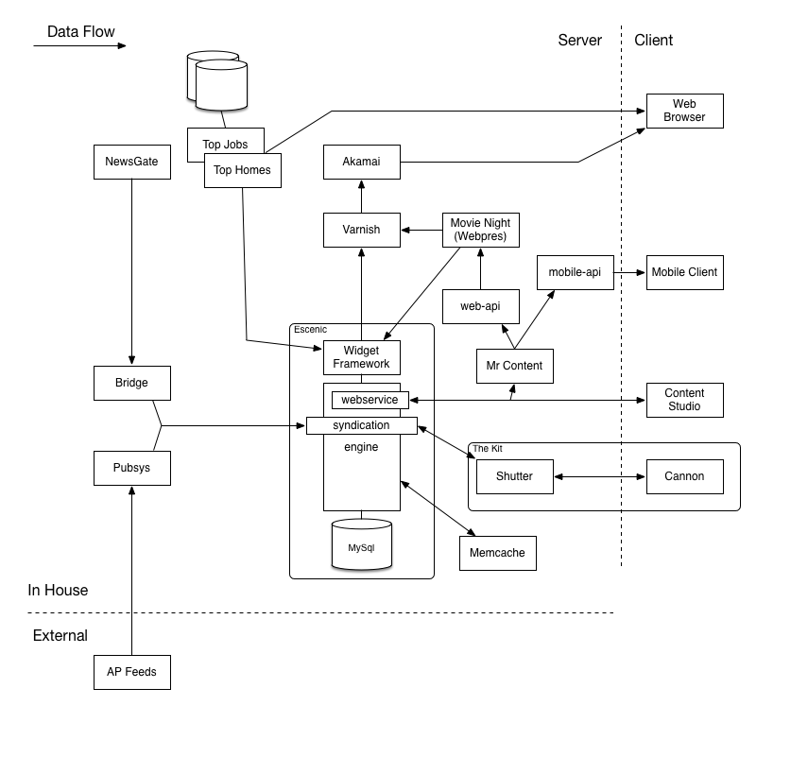
Overall Architecture

Slide 4
Content Creation
Notes:
The below and following notes on the template slides are to guide you only. In your final presentation, you may delete these notes and add relevant notes if any.
Title slide:
Title – should not exceed beyond 3 lines, font size 30-34, Arial Headings
(Font size for the title of the PPT can vary between 30-34, Arial Headings, Bold depending on the amount of text, however should not be smaller than 30 font size)
Name should not exceed beyond 1 line, Designation; font size to remain at 18, Arial Headings
Please keep the title slide simple, just the logo, title and name and designation to appear. No other graphic elements or any design, photograph, image can be added to this slide, alignment to remain the same

Slide 5
Content Flows
Content Generation
From News Gate
From Third party Feed
From Videolicious
From Content Studio

Slide 6
News Gate Flow

Slide 7
How Stories From News Gate Are Accessed As Article By User
Content creation happens in NG
Through Bridge(Plugin provided by NG),the content is available as a package(content as text, assets like video(s) and image(s)) file to ECE
The unwanted tags are removed and content in memcache gets updated through Decorator
Then the content are saved in MYSQL Database
User is accessing a publication(eg. Miami Herald)
The page accessed by the user is checked for existence in the Akamai.
If data not found in Akamai check in Varnish.
Varnish also acts as Load Balancer
If data not found in Varnish then Varnish sends the request to WF. WF is deployed on 39 servers.
WF gets data from memcache that has been updated through Decorator - custom code which removes unwanted tag(s).

Slide 8
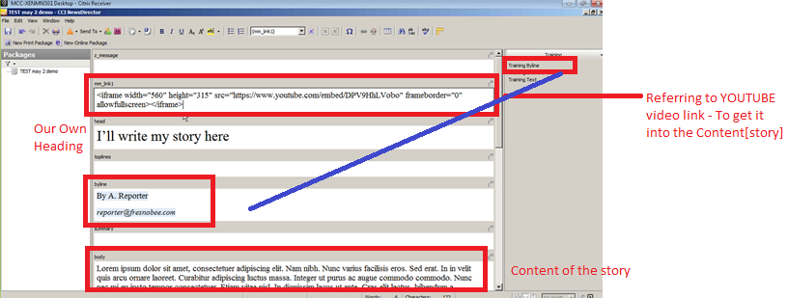
News Director – to edit the story / Article
After Launching News Access Home Page
Navigate to My Home Folder >> New story Folder >> Under Summary Section “Enter the summary” and Click “Save”.
Select Story Folder >> Right click >> New >> Text >> we will be directed to “News Director” Page.
We will be entering
mm_Link1 -> Referring to Video link[ Note : if the video is from local machine – Drag into the content slide, from there it can uploaded into Story]
Head -> Can give our own heading related to story
Byline -> Contains details of the reporter
Body -> Will contain the entire content of the story
Notes:
Content Slide: This is usually the most frequently used slide in every presentation.
Use this slide for Text heavy slides. Text can only be used in bullet points
Title Heading – font size 30, Arial Heading
Slide Content – Should not reduce beyond Arial body font 16
If you need to use sub bullets please use the indent buttons located next to the bullets buttons in the tool bar and this will automatically provide you with the second, third, fourth & fifth level bullet styles and font sizes
Please note you can also press the tab key to create the different levels of bulleted content

Slide 9
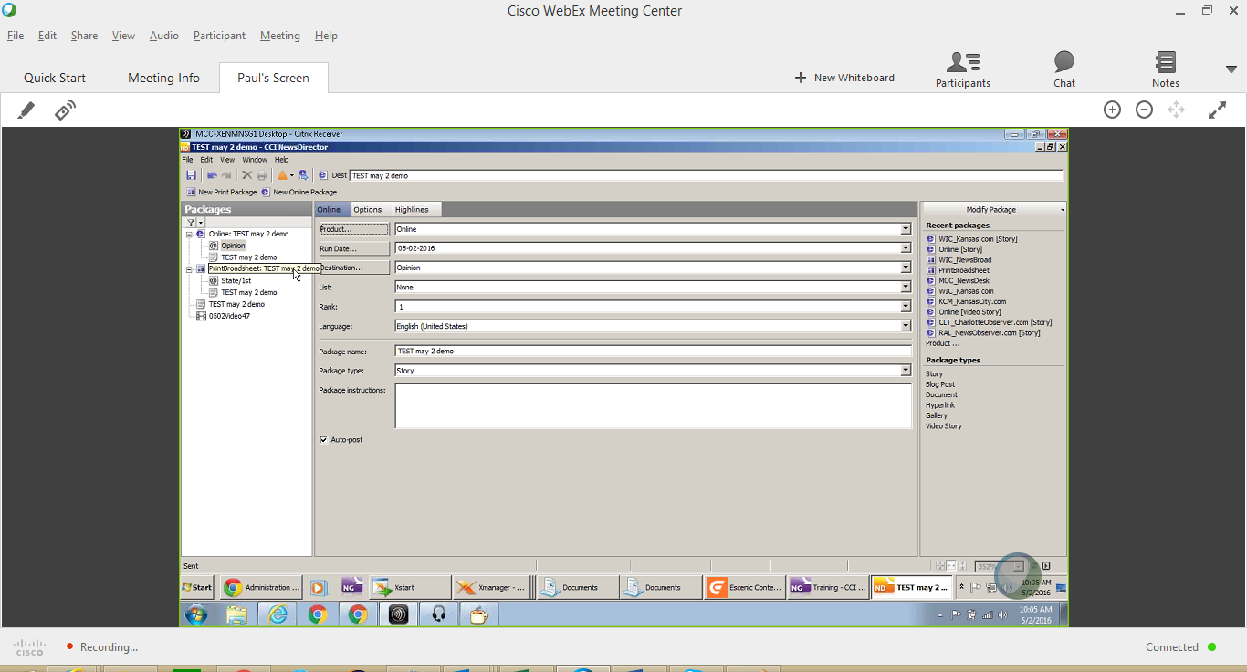
News Director – Packages
Once the story is Ready >> Online and Print Packages can be created.
If the story contains any video, By default it will get excluded in Print Package.
We will be entering
Product -> Select the appropriate Market
Run Date -> Enter the date on which the story has to get published
Destination -> Select the selection under which the story has to get publish[Sports, Health, etc.]
List and Rank -> Position of the story [ 1st, 2nd..] [ Note: Based on the Selection of List, Rank should be selected]
Notes:
Content Slide: This is usually the most frequently used slide in every presentation.
Use this slide for Text heavy slides. Text can only be used in bullet points
Title Heading – font size 30, Arial Heading
Slide Content – Should not reduce beyond Arial body font 16
If you need to use sub bullets please use the indent buttons located next to the bullets buttons in the tool bar and this will automatically provide you with the second, third, fourth & fifth level bullet styles and font sizes
Please note you can also press the tab key to create the different levels of bulleted content

Slide 10
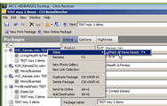
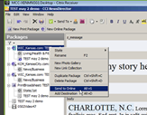
News Director – Ready / Send to Escenic
Select Package >> right click >> Select “State” >> Select “mark All Items Ready F4” >> Now the story is ready to Send to Escenic .
Select Package >> right click >> Select “Send to Online” >> Now the story will be available in Escenic.
Notes:
Content Slide: This is usually the most frequently used slide in every presentation.
Use this slide for Text heavy slides. Text can only be used in bullet points
Title Heading – font size 30, Arial Heading
Slide Content – Should not reduce beyond Arial body font 16
If you need to use sub bullets please use the indent buttons located next to the bullets buttons in the tool bar and this will automatically provide you with the second, third, fourth & fifth level bullet styles and font sizes
Please note you can also press the tab key to create the different levels of bulleted content

Slide 11
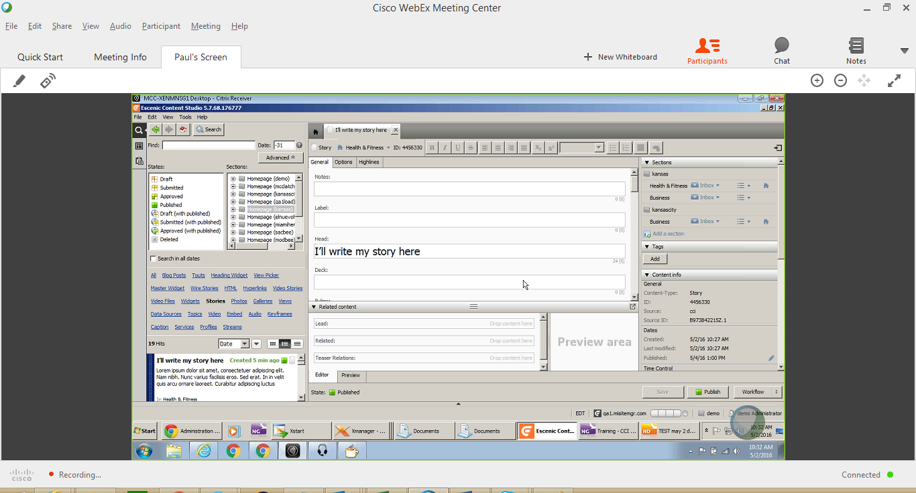
Escenic Content Studio / Publish
Launch Content Studio >> Click “Stories”
Select the Story created in NG -> based on the Head line
Can make changes – if required, Then click “Publish” Button to publish the story
Notes:
Content Slide: This is usually the most frequently used slide in every presentation.
Use this slide for Text heavy slides. Text can only be used in bullet points
Title Heading – font size 30, Arial Heading
Slide Content – Should not reduce beyond Arial body font 16
If you need to use sub bullets please use the indent buttons located next to the bullets buttons in the tool bar and this will automatically provide you with the second, third, fourth & fifth level bullet styles and font sizes
Please note you can also press the tab key to create the different levels of bulleted content

Slide 12
Third Party Feed Flow

Slide 13
About Feed File
Feed file should be NITF (News Industry Text Format)
Feed file can have a maximum of 1000 stories
Each and every story has a unique external key and this cannot be modified.

Slide 14
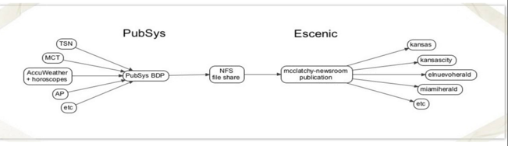
SYNDICATION of Feeds
Work Flow
Feeds from AccuWeather/TSN/AP/Reuters etc are stored in PubSys.
Notes:
Content Slide: This is usually the most frequently used slide in every presentation.
Use this slide for Text heavy slides. Text can only be used in bullet points
Title Heading – font size 30, Arial Heading
Slide Content – Should not reduce beyond Arial body font 16
If you need to use sub bullets please use the indent buttons located next to the bullets buttons in the tool bar and this will automatically provide you with the second, third, fourth & fifth level bullet styles and font sizes
Please note you can also press the tab key to create the different levels of bulleted content

Slide 15
SYNDICATION of Feeds
BDP takes feed from AP FTP server
BDP copies content from feed to PubSys (XML)
Content is copied from PubSys to NFS ( Syndication Process)
From NFS content is pushed to McClatchy-newsroom publication through import/export service
Section based CSV file is maintained and based on the section content is populated in the respective widget to all other publications
Import Service:
Transforms Pubsys XML to Escenic XML
Pubsys filter properties file has the directory name from which data is obtained and the type of data and calls the Prefilter
Prefilter calls the Java class which handles the functionality
Section mapping is done through Feature file.
Accordingly the content is mapped in CS
Image processing is not handled
Pubsys XML has an unique key for every story
This unique Key is mapped to CS Source ID

Slide 16
Videolicious Workflow

Slide 17
Videolicious Process
Auto Publish Options
Uploaded and Published Videos are placed in FTP server IN folder
IN folder comprises of ZIP Package (each for a story).
Every ZIP has a XML and MP4 file(s)
Cron job unzips the file and puts it into respective folders (XML is stored in a separate folder and MP4s are stored in a separate folder).

Slide 18
Content Studio Flow

Slide 19
Content Studio Flow
Any type of content creation can happen directly through CS
Marketing or Promotional event related contents are created directly through CS
CRUD (Creating/Reading/Updating/Deleting) operations on articles and other content types, teaser creation, image edition, time control, tagging, and many other features can be done through CS
Based on built in and out of box filters the unwanted tags in the content created are removed in Escenic
Finally content are saved in MYSQL Database

Slide 20
Video Processing Flow from Escenic Content Studio
Video content could be obtained from NG and Videolicious
On click of Publish button on CS, Video is copied to “in” bucket in AWS.
AWS Transcoder is used for transcoding the videos.
After transcoding, videos are created in out bucket in AWS.
Videos are available as CDN links to Escenic and are stored in Amazon Cloud Front.
Thumbnails are created in AWS and stored in Escenic
Thumbnails obtained through transcoder are used in the gallery content type.
Video File content type holds the raw binary video which works as an independent entity.
Video Story content type refers to the story with text and placement of video(s) in it.
The Content type name and other meta data/fields should get matched with NG content types. It ensures proper mapping and integration between NG and ECS through the bridge.
Notes:
Section breaker slide
Used for a section heading. You may add a sub heading not exceeding one line also here
Section heading – Arial Headings, bold, 34 font size, should not exceed beyond 1 line
Sub Head – Arial Headings, normal, 18 font size, should not exceed beyond 1 line

Slide 21
Widget Framework – Widget Creation, Movie Night, Tag Libraries, Content Types
Notes:
The below and following notes on the template slides are to guide you only. In your final presentation, you may delete these notes and add relevant notes if any.
Title slide:
Title – should not exceed beyond 3 lines, font size 30-34, Arial Headings
(Font size for the title of the PPT can vary between 30-34, Arial Headings, Bold depending on the amount of text, however should not be smaller than 30 font size)
Name should not exceed beyond 1 line, Designation; font size to remain at 18, Arial Headings
Please keep the title slide simple, just the logo, title and name and designation to appear. No other graphic elements or any design, photograph, image can be added to this slide, alignment to remain the same

Slide 22
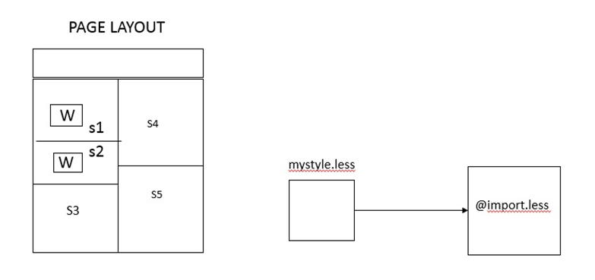
Widget Framework – Page Layout
Each page layout contains many sections
Each section contains many widgets which loads the appropriate content
Custom Widget styling can be provided in a separate stylesheet
The above stylesheet gets imported to the master sheet

Slide 23
Widget Creation in Content Studio
Widgets creation in Content Studio happens through
1) Content Studio UI mode
2) Code base following Escenic Implementations
Notes:
Content Slide: This is usually the most frequently used slide in every presentation.
Use this slide for Text heavy slides. Text can only be used in bullet points
Title Heading – font size 30, Arial Heading
Slide Content – Should not reduce beyond Arial body font 16
If you need to use sub bullets please use the indent buttons located next to the bullets buttons in the tool bar and this will automatically provide you with the second, third, fourth & fifth level bullet styles and font sizes
Please note you can also press the tab key to create the different levels of bulleted content

Slide 24
Content Studio UI mode – Widget Creation
Story creation happens in NG
Page comprises sections
Sections hold widgets
Widgets are populated with content
Page layout refers to article layout. Article layout remains same throughout all publications. Custom article layout is not created as it reflects in all publications.
Custom section based layout can be created
Inside section provide a wrapper class for Widget.
Create a new widget
Create a new View for the Widget
Publish the Widget
Once deployed the widget is available to all publications
Enabling & Disabling of widgets cannot be done in ECS directly
Enabling & Disabling of widgets happen through Enabling & Disabling of sections
.
Notes:
Content Slide: This is usually the most frequently used slide in every presentation.
Use this slide for Text heavy slides. Text can only be used in bullet points
Title Heading – font size 30, Arial Heading
Slide Content – Should not reduce beyond Arial body font 16
If you need to use sub bullets please use the indent buttons located next to the bullets buttons in the tool bar and this will automatically provide you with the second, third, fourth & fifth level bullet styles and font sizes
Please note you can also press the tab key to create the different levels of bulleted content

Slide 25
Custom Widget Creation through Escenic Implementation
Have a properties file which contains the details of the Java class and JSP of the respective widget
Template is created via default.jsp ,default template file provided through Escenic. It can be overridden
Java class provides the core functionality and business logic for the widget
JSP file provides the view of the widget.
Notes:
Content Slide: This is usually the most frequently used slide in every presentation.
Use this slide for Text heavy slides. Text can only be used in bullet points
Title Heading – font size 30, Arial Heading
Slide Content – Should not reduce beyond Arial body font 16
If you need to use sub bullets please use the indent buttons located next to the bullets buttons in the tool bar and this will automatically provide you with the second, third, fourth & fifth level bullet styles and font sizes
Please note you can also press the tab key to create the different levels of bulleted content

Slide 26
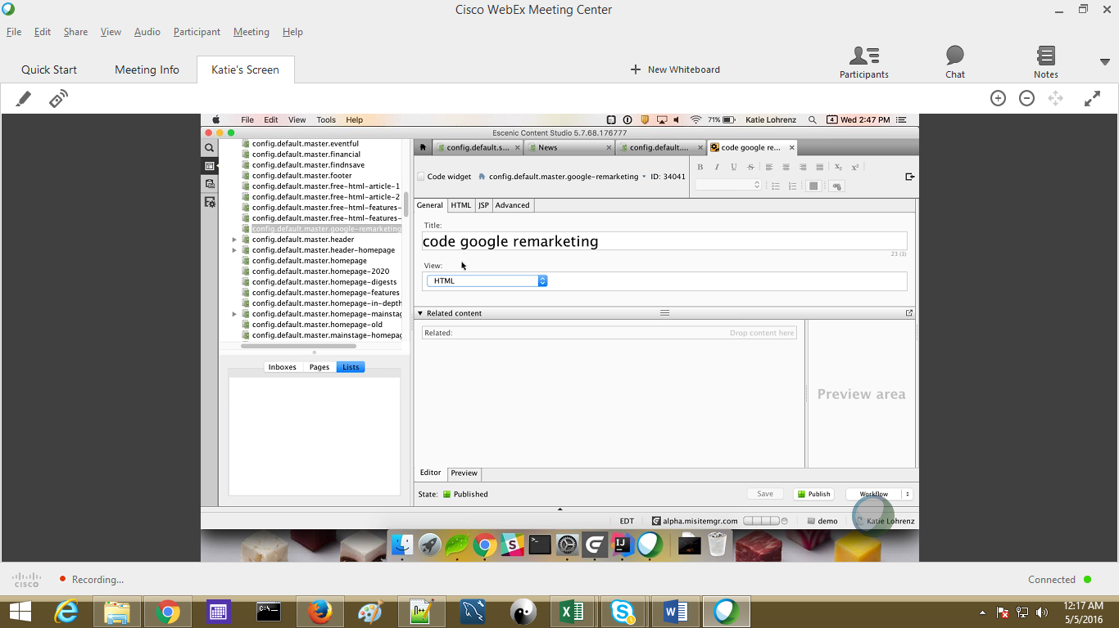
Custom Widget Creation through Escenic Implementation
Widgets are created through code based widget with the following options,
HTML – HTML Code can be directly provided in ECS
JSP – JSP page is created and deployed. Provide the JSP file path in the path parameter
Notes:
Content Slide: This is usually the most frequently used slide in every presentation.
Use this slide for Text heavy slides. Text can only be used in bullet points
Title Heading – font size 30, Arial Heading
Slide Content – Should not reduce beyond Arial body font 16
If you need to use sub bullets please use the indent buttons located next to the bullets buttons in the tool bar and this will automatically provide you with the second, third, fourth & fifth level bullet styles and font sizes
Please note you can also press the tab key to create the different levels of bulleted content

Slide 27
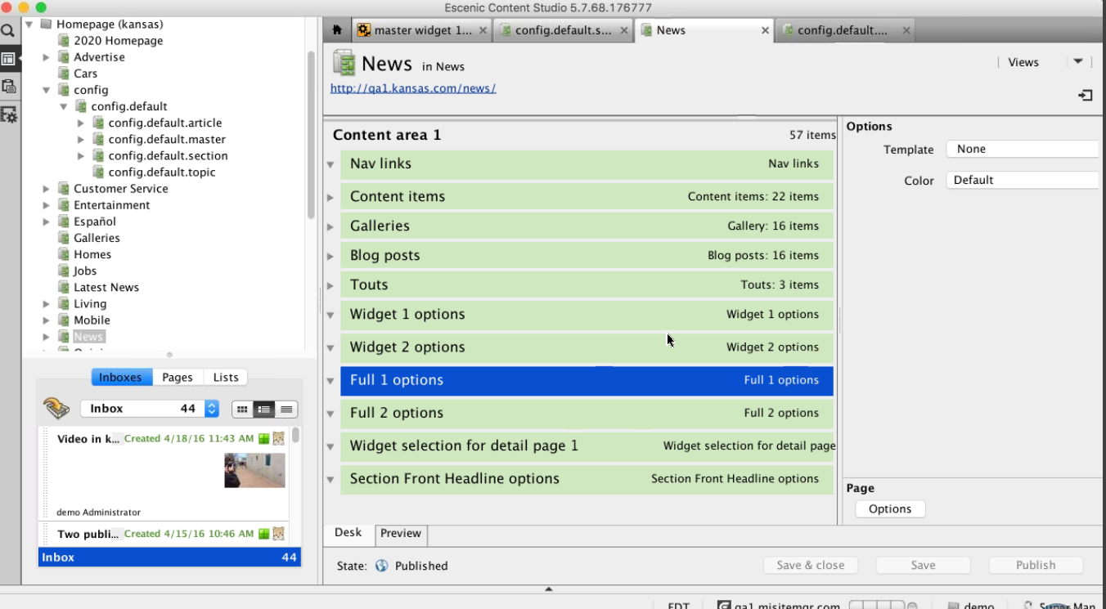
Assignment of Widgets to Sections
Already existing widgets are available to all publications.
Each and every publication would assign the widgets to the particular section.
No drag and drop for ordering the widgets.
Based on the creation of widgets, the ordering happens on the WF
Widget once created are assigned with the particular section template.
We have different config section for every publication or the market
Each section have separate templates/config files for them
Notes:
Content Slide: This is usually the most frequently used slide in every presentation.
Use this slide for Text heavy slides. Text can only be used in bullet points
Title Heading – font size 30, Arial Heading
Slide Content – Should not reduce beyond Arial body font 16
If you need to use sub bullets please use the indent buttons located next to the bullets buttons in the tool bar and this will automatically provide you with the second, third, fourth & fifth level bullet styles and font sizes
Please note you can also press the tab key to create the different levels of bulleted content

Slide 28
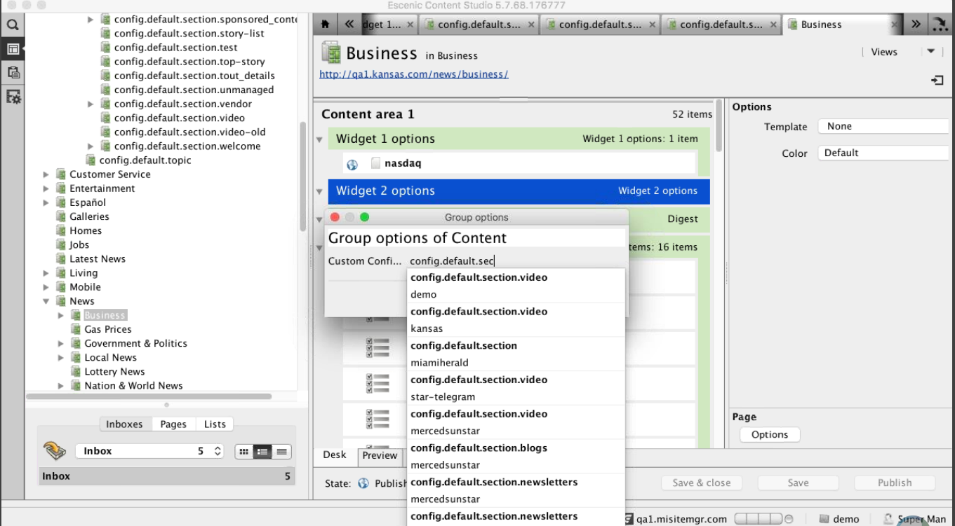
Assignment of Content to Widgets
The widgets are assigned with content.
The content inside the widget is configurable
Layout group file holds the section and the widgets under each section
Each widget is available as link and can be tested in the browser.
Modifying a layout-group file is manually done
Notes:
Content Slide: This is usually the most frequently used slide in every presentation.
Use this slide for Text heavy slides. Text can only be used in bullet points
Title Heading – font size 30, Arial Heading
Slide Content – Should not reduce beyond Arial body font 16
If you need to use sub bullets please use the indent buttons located next to the bullets buttons in the tool bar and this will automatically provide you with the second, third, fourth & fifth level bullet styles and font sizes
Please note you can also press the tab key to create the different levels of bulleted content

Slide 29
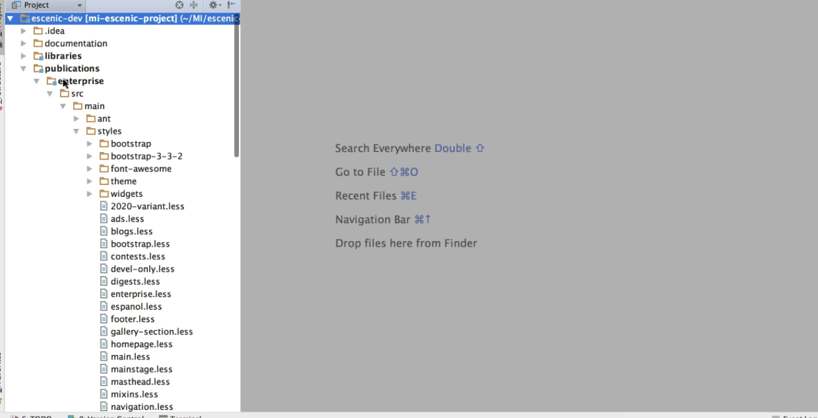
Custom Styling/JS/JSP
The basic layout happens through WF.
In the backend WF holds JSP /JS and CSS files.
Each and every publication has a custom stylesheet (.less file)
Notes:
Content Slide: This is usually the most frequently used slide in every presentation.
Use this slide for Text heavy slides. Text can only be used in bullet points
Title Heading – font size 30, Arial Heading
Slide Content – Should not reduce beyond Arial body font 16
If you need to use sub bullets please use the indent buttons located next to the bullets buttons in the tool bar and this will automatically provide you with the second, third, fourth & fifth level bullet styles and font sizes
Please note you can also press the tab key to create the different levels of bulleted content

Slide 30
Widget Framework – Movie Night Video Rendering Flow
If section holds a widget for rendering video, <video> tag gets replaced with the actual video content
If <video> tag is found, internally Escenic call Custom Tag Library(CTL)
In feature file ,WPS value have been set manually
CTL looks for the WPS value
WPS value TRUE indicates that Video rendering happens through Movie Night (WPS Layer)
WPS value FALSE indicates that Video rendering happens through Widget Framework
If WPS value is TRUE for a publication, then video is loaded from Movie Night provided from Node JS.
The Node JS provides the video output as a string which is passed to the Widget and it replaces <video>

Slide 31
TAG LIBRARIES in Movie Night
We can create Custom Tag in a JSP/HTML file
Hence we need to provide a specific action that has to be handled for the tag as the custom tags cannot be understood by Browser
When the custom tag is rendered it will go through the particular action and finally rendered a HTML tag.
Custom tag library:
Define a custom tag in JSP file
Include tag library(.tld) file in the JSP
The tag library provides the mapping between the custom tags and the java class
In the Java class apart from the actions associated with the tag provided, doTag method calls WPS layer(http://domain name:port> which is deployed in docker image. WPS application is used for building a templates using NodeJS, Nunjucks and Express.
mipageinfo has section info.
We cannot have different configurations in server and client.
Mi-core-tag and mi-fn-tag are used at the code level(http://confluence.mcclatchyinteractive.com/display/escenic/MI+Core+tags)
More information can be obtained in the below confluence link, http://confluence.mcclatchyinteractive.com/display/escenic/Support+classes
In JSP file, correct ordering of tags should be preserved as that will mess that java script object as is it very sensitive.
A JavaScript object is created which has all the required attributes. Based on these attributes the tag is displayed.
Notes:
Content Slide: This is usually the most frequently used slide in every presentation.
Use this slide for Text heavy slides. Text can only be used in bullet points
Title Heading – font size 30, Arial Heading
Slide Content – Should not reduce beyond Arial body font 16
If you need to use sub bullets please use the indent buttons located next to the bullets buttons in the tool bar and this will automatically provide you with the second, third, fourth & fifth level bullet styles and font sizes
Please note you can also press the tab key to create the different levels of bulleted content

Slide 32
Section Parameters and Features Properties
Two types of parameters are used by taglib:
Section based
In section based, section changes are done at global level which can be changed at publication level. But the changes can be done only against that section in content studio.
Section based properties are based on section and being in a tree hierarchy they can inherit properties.
Feature based file
Feature based properties are distinct and we cannot override them as they are read only values and constant for one particular publication.
Feature based properties are very specific to that publication.
Example: WPS value for Video rendering through Movie Night/WF.
Notes:
Content Slide: This is usually the most frequently used slide in every presentation.
Use this slide for Text heavy slides. Text can only be used in bullet points
Title Heading – font size 30, Arial Heading
Slide Content – Should not reduce beyond Arial body font 16
If you need to use sub bullets please use the indent buttons located next to the bullets buttons in the tool bar and this will automatically provide you with the second, third, fourth & fifth level bullet styles and font sizes
Please note you can also press the tab key to create the different levels of bulleted content

Slide 33
Custom Content Types
Content type refers to the type of content that get placed in a widget
Each content type have several fields
Commonly used content types are Story, Video, Video files, Touts, Hyperlinks, Key frames, Photos, Galleries
Tout and Hyperlink do have same set of fields but differs in the usage level.
Tout is used to provide an external link and Hyperlink is used to refer another story inside a particular story or related items making it an asset for story content type
Both Photos & Key frame do have same set of fields but differs in the usage level.
Photo is used in Image galleries. Key frame are used as assets to the video story content
Notes:
Section breaker slide
Used for a section heading. You may add a sub heading not exceeding one line also here
Section heading – Arial Headings, bold, 34 font size, should not exceed beyond 1 line
Sub Head – Arial Headings, normal, 18 font size, should not exceed beyond 1 line

Slide 34
Build Deployment
Notes:
The below and following notes on the template slides are to guide you only. In your final presentation, you may delete these notes and add relevant notes if any.
Title slide:
Title – should not exceed beyond 3 lines, font size 30-34, Arial Headings
(Font size for the title of the PPT can vary between 30-34, Arial Headings, Bold depending on the amount of text, however should not be smaller than 30 font size)
Name should not exceed beyond 1 line, Designation; font size to remain at 18, Arial Headings
Please keep the title slide simple, just the logo, title and name and designation to appear. No other graphic elements or any design, photograph, image can be added to this slide, alignment to remain the same

Slide 35
Build and Deployment Flow
Escenic
Mergy WAR file + Latest Escenic
Jenkins Job
Triggers build.sh
Latest WAR filePOM.xml
Version No
Maven
Pom.xml
EAR
Artifacts of Escenic get downloaded
NEXUS
Copy by Jenkins Job
Dependency Compile(Custom code)
Staging Services
Deployment
WAR file
Unit Testing
Done through do it script
Pass Environment
SSH

Slide 36
Build and Deployment Flow
Jenkins is used for deployment
Totally 2 Jenkin servers are there
Slave is used predominantly for the build and deployment process
Master server is used for supporting legacy systems
The time taken for completing Jenkins jobs differ based on the custom code deployed and servers in the environment
Following Jobs are involved in build and deployment process
Build Job
Escenic Staging
Triggering Puppet

Slide 37
Build and Deployment Flow
Jenkins Escenic Staging copies EAR file to staging Latest WAR file is shared to Assembly Tool of Escenic
Triggering Puppet Job do the deployment by triggering puppet code
Deployment involves the following
Done through DOIT script
Pass Environment
SSH every Host
Puppet Daemon deploys the EAR file to the Host

Slide 38
3rd Party Integration – Top Homes / Top Jobs / Weather / Press+ / Synchronex
Notes:
The below and following notes on the template slides are to guide you only. In your final presentation, you may delete these notes and add relevant notes if any.
Title slide:
Title – should not exceed beyond 3 lines, font size 30-34, Arial Headings
(Font size for the title of the PPT can vary between 30-34, Arial Headings, Bold depending on the amount of text, however should not be smaller than 30 font size)
Name should not exceed beyond 1 line, Designation; font size to remain at 18, Arial Headings
Please keep the title slide simple, just the logo, title and name and designation to appear. No other graphic elements or any design, photograph, image can be added to this slide, alignment to remain the same

Slide 39
External DB - Top Jobs/Top Homes
External third party vendor
Calls Ruby on Rails Service to get the content (service makes a REST call to retrieve content from vendor DB).
Looks for the feature file for publication
Create a view and places the widget
Push the content from the service to a view file
For search functionality in Top Jobs / Top Homes the search keywords are passed as query parameters to the vendor site (for Jobs – Career Jobs, for Homes – Home Finder).
Content related to market for Top Jobs and Top Homes are maintained by the concerned third party vendors (for Jobs – Career Jobs, for Homes – Home Finder).
Notes:
Column content slide
This is a slide with 2 columns and you can have text in bullet points under each column. You can have separate header for each of the columns in the blue box provided on top of each of the columns.
Heading font size of the column should remain at 30 and the column content font size should not reduce beyond 16.

Slide 40
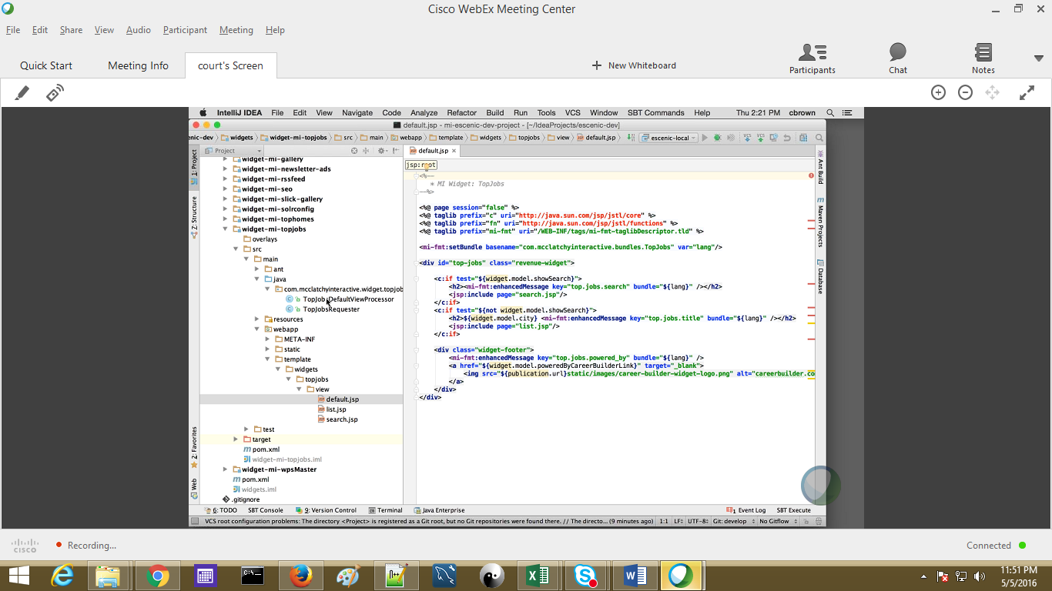
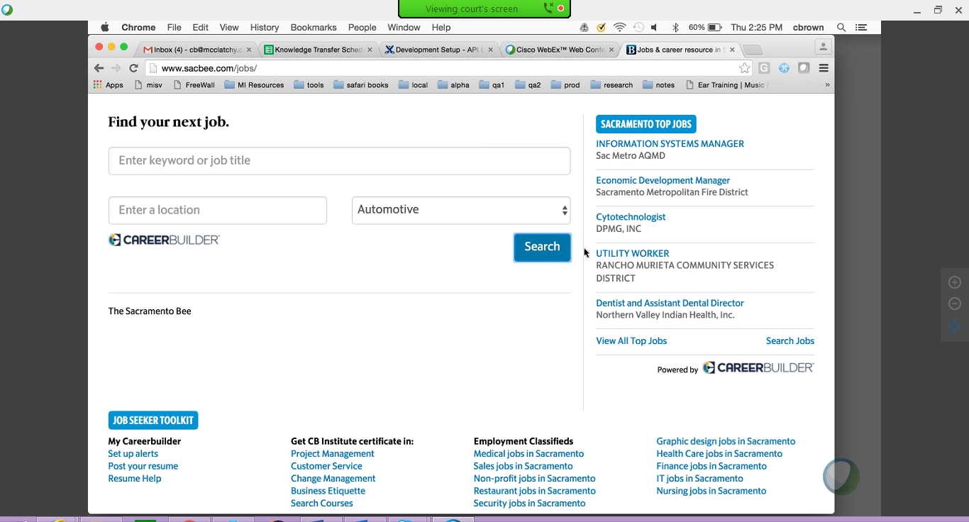
External DB - Top Homes
Notes:
Column content slide
This is a slide with 2 columns and you can have text in bullet points under each column. You can have separate header for each of the columns in the blue box provided on top of each of the columns.
Heading font size of the column should remain at 30 and the column content font size should not reduce beyond 16.

Slide 41
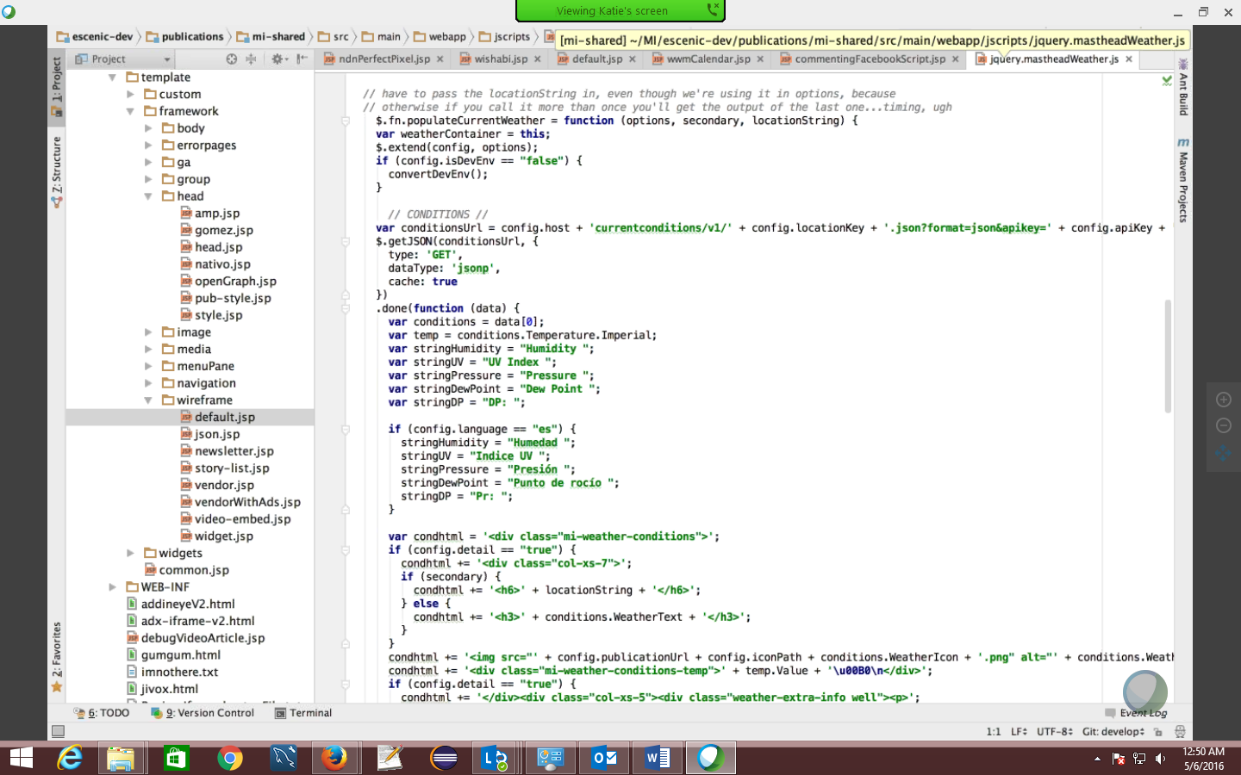
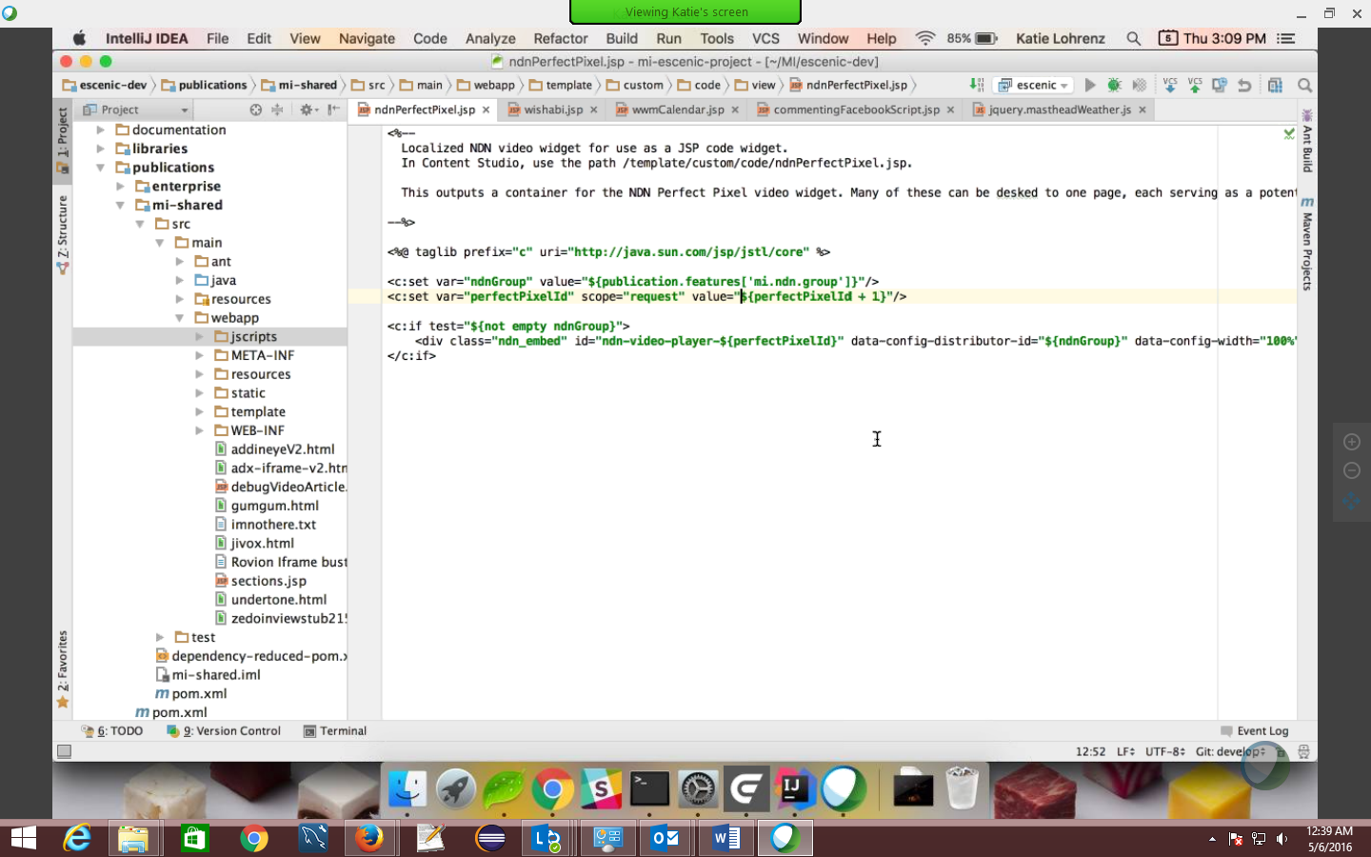
THIRD PARTY INTEGRATION
JSP File is created for every third party.
JavaScript files are included in the JSP files to fetch the values from the third party (Ex. commentingfacebookScript.jsp, wishabi.jsp)
The JSP files are mapped with the Code Widget in the Path field
jquery.mastheadWeather.js
ndnPerfectPixel.jsp
Notes:
Column content slide
This is a slide with 2 columns and you can have text in bullet points under each column. You can have separate header for each of the columns in the blue box provided on top of each of the columns.
Heading font size of the column should remain at 30 and the column content font size should not reduce beyond 16.

Slide 42
Caching – Memcache / Akamai / Varnish
Notes:
The below and following notes on the template slides are to guide you only. In your final presentation, you may delete these notes and add relevant notes if any.
Title slide:
Title – should not exceed beyond 3 lines, font size 30-34, Arial Headings
(Font size for the title of the PPT can vary between 30-34, Arial Headings, Bold depending on the amount of text, however should not be smaller than 30 font size)
Name should not exceed beyond 1 line, Designation; font size to remain at 18, Arial Headings
Please keep the title slide simple, just the logo, title and name and designation to appear. No other graphic elements or any design, photograph, image can be added to this slide, alignment to remain the same

Slide 43
Memcache:
3 memcache servers are used (i.e. Primary and 2 secondary servers).
Only primary memcache server always runs.
Other two memcache servers are idle and are ready to go
No replication is happening between the primary and the other servers
If primary goes down, secondary starts and it rebuilt the objects. Rebuild process include – replication of cache from local cache to cluster server as well.
Memcache cluster is maintained by operations
Escenic internally knows when an object changes.

Slide 44
Akamai & Varnish
User access McClatchy site, request checks whether the page exists in Akamai. If the page does not exists in Akamai then the request is send to varnish.
If page does not exists in Varnish then the request will be send to widget framework
Reverse proxy takes care of all web caching.
Page that is requested is searched in Akamai & Varnish using article-id ( i.e. cache key).
Content is compressed and stored as key value pair.
It is the browser that decompresses the same and renders it to the end user
80% of the queries are handled by Akamai and 20% by Varnish.
Site is never brought down even during deployment, the requests are handled by both Akamai or Varnish.
Akamai is also used as a CDN for content and images
Varnish is also used as a LB for WF servers.
Akamai
Varnish
Widget Framework
Notes:
Full Size Image slide
The image slides help you represent the topic visually.
Click on the icon to add image, the size of the image will be automatically determined once inserted
Except an image do not add any content in this slide

Slide 45
Logging, Monitoring and NFRs
Notes:
The below and following notes on the template slides are to guide you only. In your final presentation, you may delete these notes and add relevant notes if any.
Title slide:
Title – should not exceed beyond 3 lines, font size 30-34, Arial Headings
(Font size for the title of the PPT can vary between 30-34, Arial Headings, Bold depending on the amount of text, however should not be smaller than 30 font size)
Name should not exceed beyond 1 line, Designation; font size to remain at 18, Arial Headings
Please keep the title slide simple, just the logo, title and name and designation to appear. No other graphic elements or any design, photograph, image can be added to this slide, alignment to remain the same

Slide 46
LOGGING
Escenic uses "Log4j" to handle logging
General logging level settings are made in "trace.properties“
This file "trace.properties-presentation-leader.erb" contains
categorized based loggings
messages.log
memcached.log
misc.log
search.log
syndication.log - import and export servers logs
webservice.log
Logs will be purged after 90 days
LogStash and Kibana are also used as Log Analyzer tool
Log Analyzer tools are hosted in Docker Images
Videolicious logs will be logged separately
Error that happen while transferring the files from NG to ECE, those.
Folder with the host name is created and the respective log file will be stored under that folder.

Slide 47
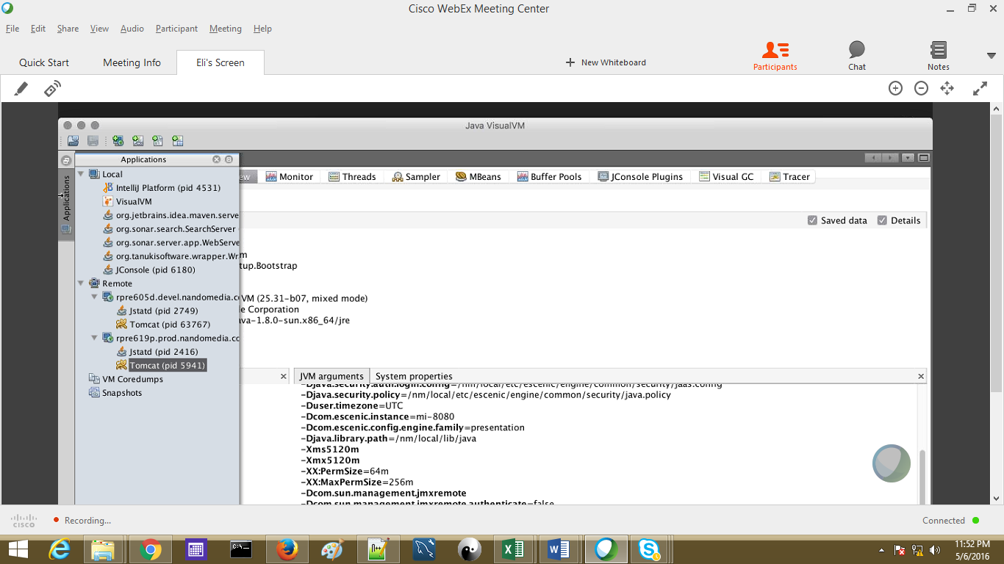
MONITORING TOOLS
JMS
Built In JMS monitor the activities through JVM arguments & System Properties
Provides information about the performance and resource consumption of applications
Statistics for the following JMS resources: JMS servers, connections, queue and topic destinations, JMS server session pools, pooled connections, active sessions

Slide 48
MONITORING TOOLS
Xymon
Legacy Software.
Xymon monitors hosts, network services. Xymon can periodically generate requests to network services - http, ftp, smtp and so on - and record if the service is responding as expected.
Xymon will also record the history of each monitored item, so can generate availability reports and check on the incidents that have occurred. Wherever possible data is also stored for trend analysis and presented as graphs
In case of problems alerts may be sent in the form of e-mails, SMS-messages or pager-alerts so that staff can respond quickly to problems without having to keep watch over the services.
Jconsole
Graphical monitoring tool to monitor JVM and Java applications
Both on a local or remote machine.
Provide information on performance and resource consumption of applications

Slide 49
Non Functional Requirements (NFRs)
Load Testing is performed
Siege is used for load testing
Gangila is used to monitor Siege
Security and Availability are handled by DevOps team
Section parameters can’t be changed. It is same for all markets only the values are changed based on a publication
Feature file holds values/attributes specific to a publication
Previously Lazy loading was handled by ECS built in feature
Movie Night is handling the lazy loading of videos using JavaScript
Cron Jobs are run in a periodic manner for cleaning the log levels
Regular checks are made in Akamai logs
Escenic access level security allows the Super User to edit the section parameters .
Section and Feature File attributes are provided and monitored regularly by a team separately.
Notes:
Content Slide: This is usually the most frequently used slide in every presentation.
Use this slide for Text heavy slides. Text can only be used in bullet points
Title Heading – font size 30, Arial Heading
Slide Content – Should not reduce beyond Arial body font 16
If you need to use sub bullets please use the indent buttons located next to the bullets buttons in the tool bar and this will automatically provide you with the second, third, fourth & fifth level bullet styles and font sizes
Please note you can also press the tab key to create the different levels of bulleted content

